Slide 1

What is the effect of self-efficacy on students’ participation?
Investigators:
Julian Williams (PI), Laura Black, Pauline Davis, Birgit Pepin and Geoff Wake
Research Associates: Valerie Farnsworth, Paul Hernandez-Martinez, Maria Pampaka
Associate Research Fellow: Diane Harris
Associate Research Students: Kamila Jooganah and Irene Kleanthous
Research Statistician: Graeme Hutcheson
Administrator: Tim Millar

Slide 2
Professor Bandura has written the following on the distinction between self-efficacy and confidence
“ Perceived self-efficacy refers to belief in one's agentive capabilities, that one can produce given levels of attainment. A self-efficacy assessment, therefore, includes both an affirmation of a capability level and the strength of that belief. Confidence is a catchword rather than a construct embedded in a theoretical system. Advances in a field are best achieved by constructs that fully reflect the phenomena of interest and are rooted in a theory that specifies their determinants, mediating processes, and multiple effects. Theory-based constructs pay dividends in understanding and operational guidance. The terms used to characterize personal agency, therefore, represent more than merely lexical preferences."
Self-Efficacy: The Exercise of Control, 1997, p. 382

Slide 3
What is Mathematics Self-Efficacy?
Self-efficacy (SE) beliefs “involve peoples’ capabilities to organise and execute courses of action required to produce given attainments” and perceived self-efficacy “is a judgment of one’s ability to organise and execute given types of performances…” (Bandura 1997, p. 3)
"a situational or problem-specific assessment of an individual's confidence in her or his ability to successfully perform or accomplish a particular maths task or problem" (Hackett & Betz, 1989, p. 262)

Slide 4
Why self efficacy is interesting?
Important in students’ decision making (sometimes more than actual test scores)
Positive influence on students’ academic choices, effort and persistence, and choices in careers related to maths and science.
How to measure?
Contextualised questions

Slide 5
Two of the Projects and Samples
Total | 1779 | 1076 | 604
AS Trad | 1285 (72%) | 730 (68%) | 459 (76%)
UoM | 494 (28%) | 346 (32%) | 145 (24%)
1778 | 875 | 901
AS Trad: A traditional mathematics A-level
UoM: a ‘modelling’-based programme intended to widen participation in mathematics through use of technology and coursework.

Slide 6
Measuring Mathematics Self Efficacy
MSE Instrument of 30 items:
3 difficulty levels
7 mathematical competences
Pure and Applied/Modelling
MSE Instrument of 10 items of different mathematical areas
Confidence in the same 10 mathematical areas

Slide 7
Example ‘Applied’ Item (common in both studies)

Slide 8
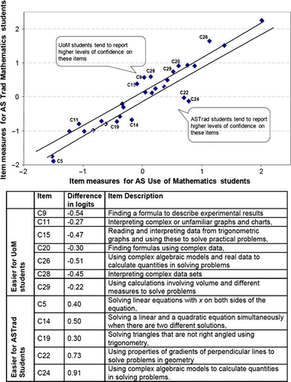
Measuring Self Efficacy - TLRP
Investigation of these items shows that those easier for AS traditional students are items defined earlier as ‘pure’ whereas, in contrast, items easier for the Use of Mathematics (UoM) group are more ‘applied’ items.
One Overall measure (MSE),
And two useful sub-scales:
Pure MSE
Applied MSE

Slide 9
What we found regarding MSE
consistent positive relationships of MSE with students’ prior mathematical attainment
male students were more self-efficacious
Notes:
Point 2 -Gender - male students were more self-efficacious when an overall or an applied measure is used, but not higher in the pure dimension.
Point 3 –variables that affect MSE over time - one of these variables is the programme the students are attending, which appeared to have a significant effect on improving their overall mathematics self-efficacy between the beginning of their AS year and the end, with more evident improvement in the Use of Mathematics programme.

Slide 10
MSE changing during the AS course
AS traditional students score consistently higher in the pure MSE aspect, and the difference increases with time
UoM students also increase their scores in the applied dimension considerably over the AS course.

Slide 11
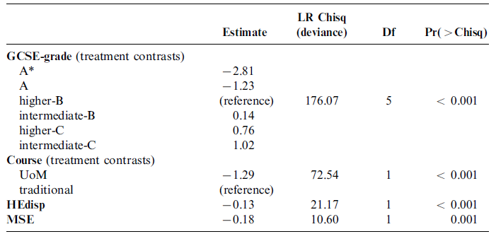
MSE and Learning Outcomes:
A logistic regression model of drop-out
The probability of dropout reduces when MSE increases (controlling for the other variables in the model)

Slide 12
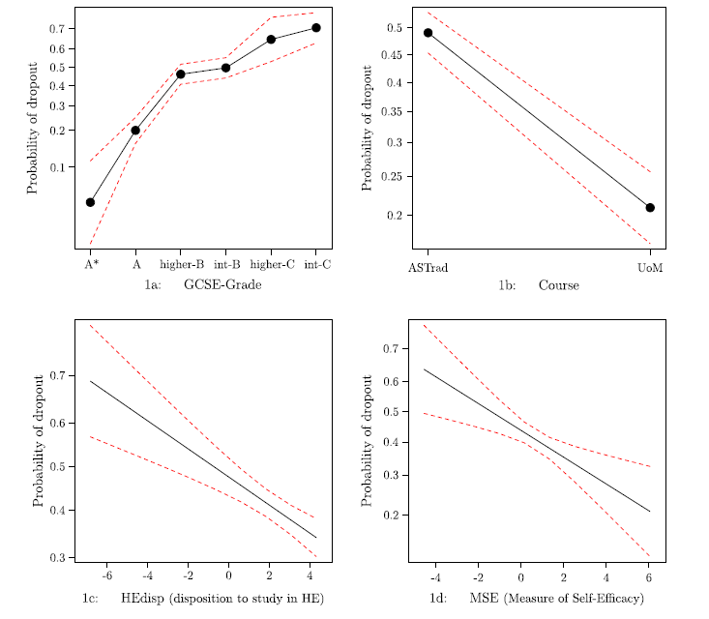

Slide 13
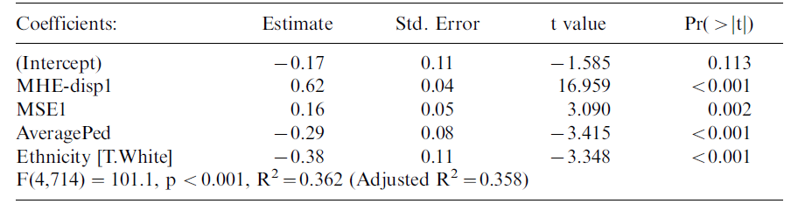
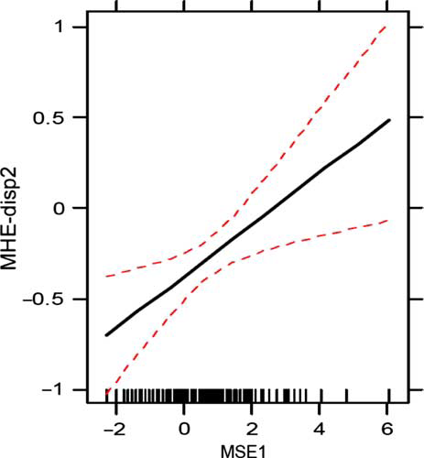
MSE and Other Learning Outcomes (Dispositions - TLRP)
Linear Model of Maths Disposition at DP2
The reported MSE of the students at the beginning of their MSE programme has a positive effect on their dispositions to continue with mathematically demanding subjects (which is directly relevant to particular career choices)

Slide 14
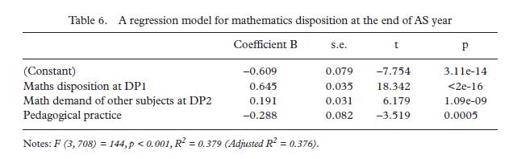
Another model…

Slide 15
MSE and Other Learning Outcomes (Dispositions - TransMaths
➔ A consistent association of MSE with changing mathematics dispositions during first year university study

Slide 17
A final point – from TransMaths
MSE measure highly correlated with ‘confidence’ measure
We only measure MSE at the beginning, but confidence at all data points (up to the 2nd Year at University)
How is confidence changing during University?

Slide 18
TransMaths ‘ mathematics confidence’
Notes:
Course –
As expected students of ‘other’ than mathematics and engineering/science course are less confident with mathematics when starting their courses, however this difference is only statistically significant between mathematics and other students.
During the course of the years, the difference is increasing, since by Year 2 mathematics and engineering/science students seem to be more confident, while students of other courses show a decrease in their mathematics confidence.
Gender-
Gender differences are statistically significant at all survey times: Male students are overall more confident and they seem to increase their confidence scores a little. In contrast, we can observe a slight drop in female students’ confidence with mathematics from the start of their course and up to the middle of their second year at university.

Slide 19
Conclusions
due to the significant role of mathematics self-efficacy in students’ future career choices, teachers, educational policy-makers and practitioners should endeavour to promote and develop students’ mathematics self-efficacy.
Use of Mathematics seems to benefit students to increase their MSE, (especially on students with low mathematics self-efficacy).

